Slide 1

Using Bootstrap with your Qlik Sense Extension or Mashup
Kevin McGovern, Slalom
Qonnections 2016

Slide 2





Kevin McGovern
Four years using QlikView
Early adopter of Qlik Sense
Experience building mashups and extensions
Contributor to Qlik Branch
Consultant with Slalom for 1 ½ years
Industries: financial services, education, life sciences, and healthcare
mcgovey
@mcgovey
Slalom Consulting
kmcgovern1
Notes:
Experience with both QV and QS
Experience with mashups and extensions
built mashups for competitions, built for clients, extensions 4 contributions to Branch
Been at slalom consulting a year and half. Systems integrator partner

Slide 3
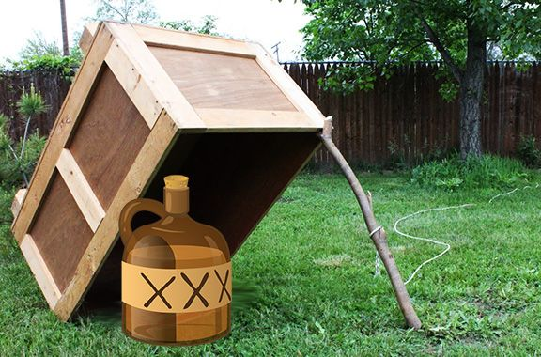
Funnyordie.com
Notes:
Booze Trap

Slide 4

Notes:
Boot cat aka puss in boots

Slide 5


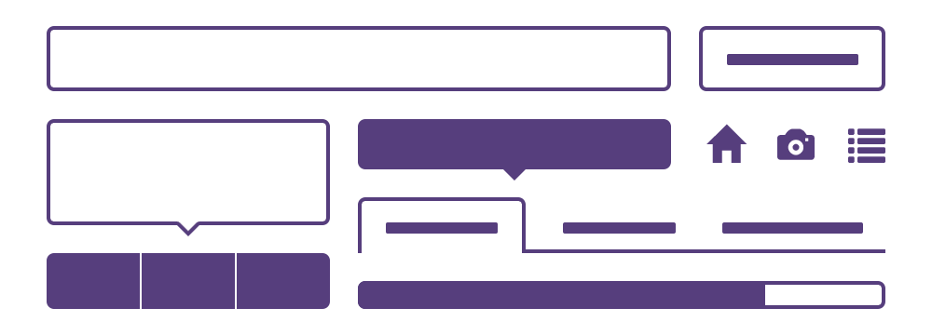
What is Bootstrap
Web framework
Mobile and Desktop
Build consistent projects
Takes the pain out of web development
Lots of features
All about user experience
Notes:
Web framework – always will hear that – what does it mean
Websites that work well on mobile and desktop
Create a header and Bootstrap will auto scale depending on screen size
Really difficult to build web pages that look good everywhere
(all been to websites like that)

Slide 6
“Bootstrap is the most popular HTML, CSS, and JS framework for developing responsive, mobile first projects on the web.”
getbootstrap.com
“Today’s websites should be modern, sleek, responsive, and mobile first. Bootstrap helps us to achieve these goals with minimum fuss.”
sitepoint
Notes:
Bootstrap explanation
Testimonial from sitepoint
what is it used for
Websites that work great on desktop and mobile
Used to quickly build good looking websites
Makes it easy to build websites that work great on desktop and mobile

Slide 7

Why are you here
Familiar with Qlik Sense
May have some experience with mashups or building websites
Goals of session
Understand what Bootstrap is
Recognize key components to start to think about how to use them
Learn how to begin implementing this in a mashup
Comprehend steps needed to use in an extension
Notes:
At the very least know what QS is and some of the key functionality
Show of hands who here has built either a mashup or an extension
Maybe built a mashup, saw some funny code, didn't know what it was so deleted it and didn't use it
Maybe you've looked at mashups but decided it's too hard to make it look nice
Some of you may have some experience designing web pages but for those of you that don't, going to try to explain
Goal, understand what it is, what it does, demo give you a 10000 ft view of how you do some of this so that you have an understanding of BS and can go try it on your own

Slide 8
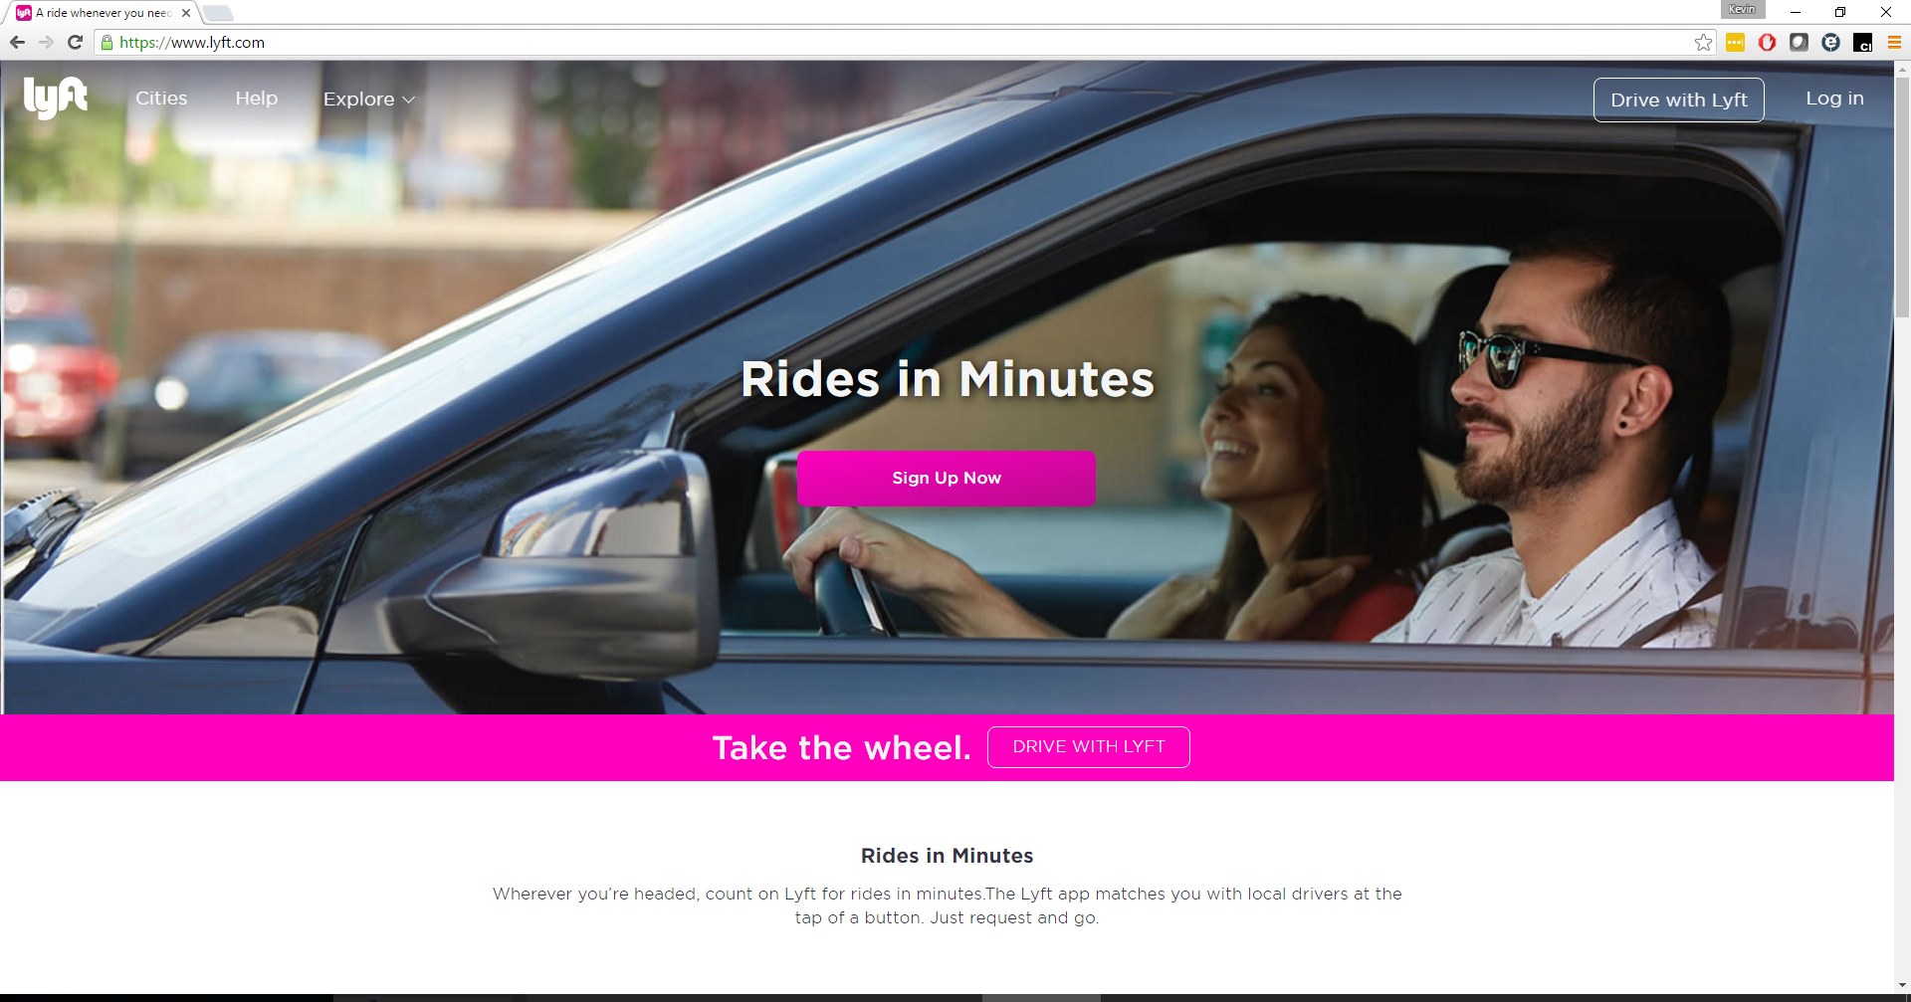
Notes:
Where might you have seen Bootstrap?
1.2k of 10k websites use Bootstrap in some capacity according to built
Buttons - bootstrap

Slide 9
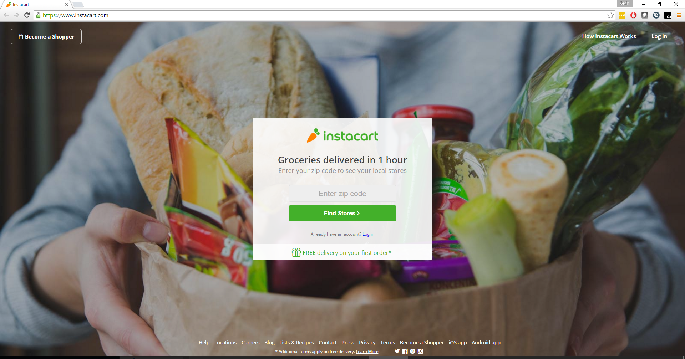
Notes:
Input box

Slide 10
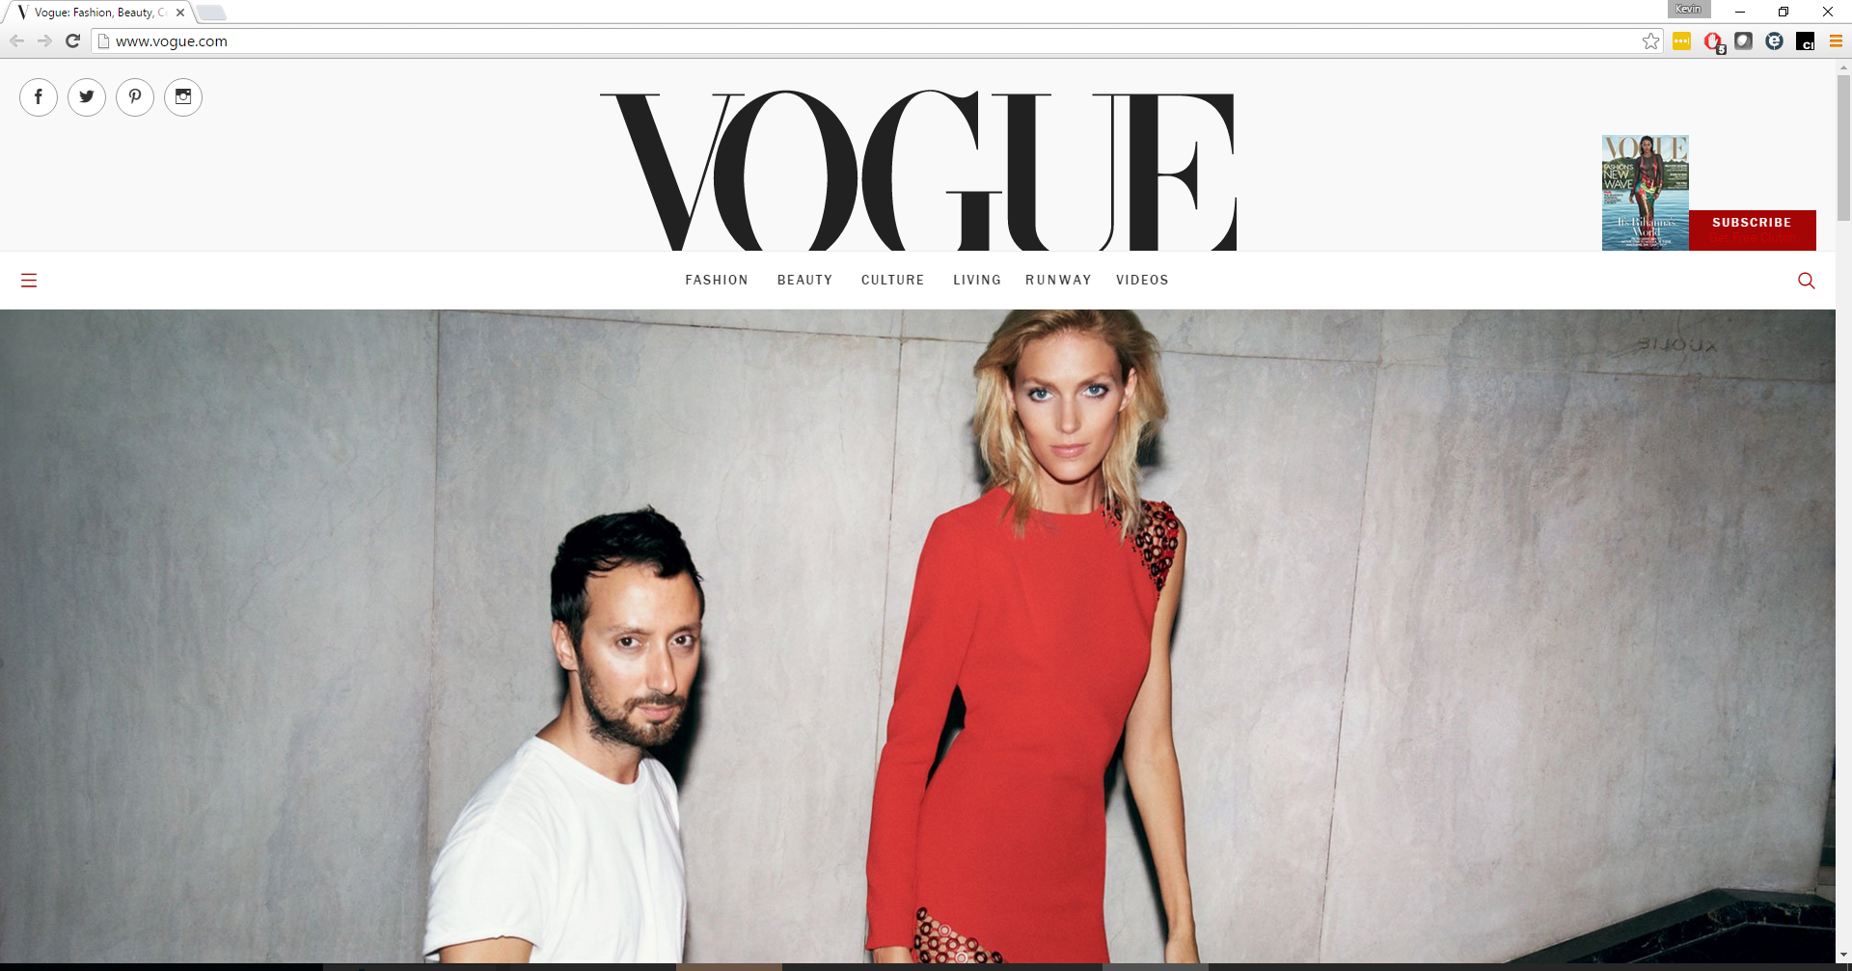
Notes:
Navigation dropdown on the left

Slide 11
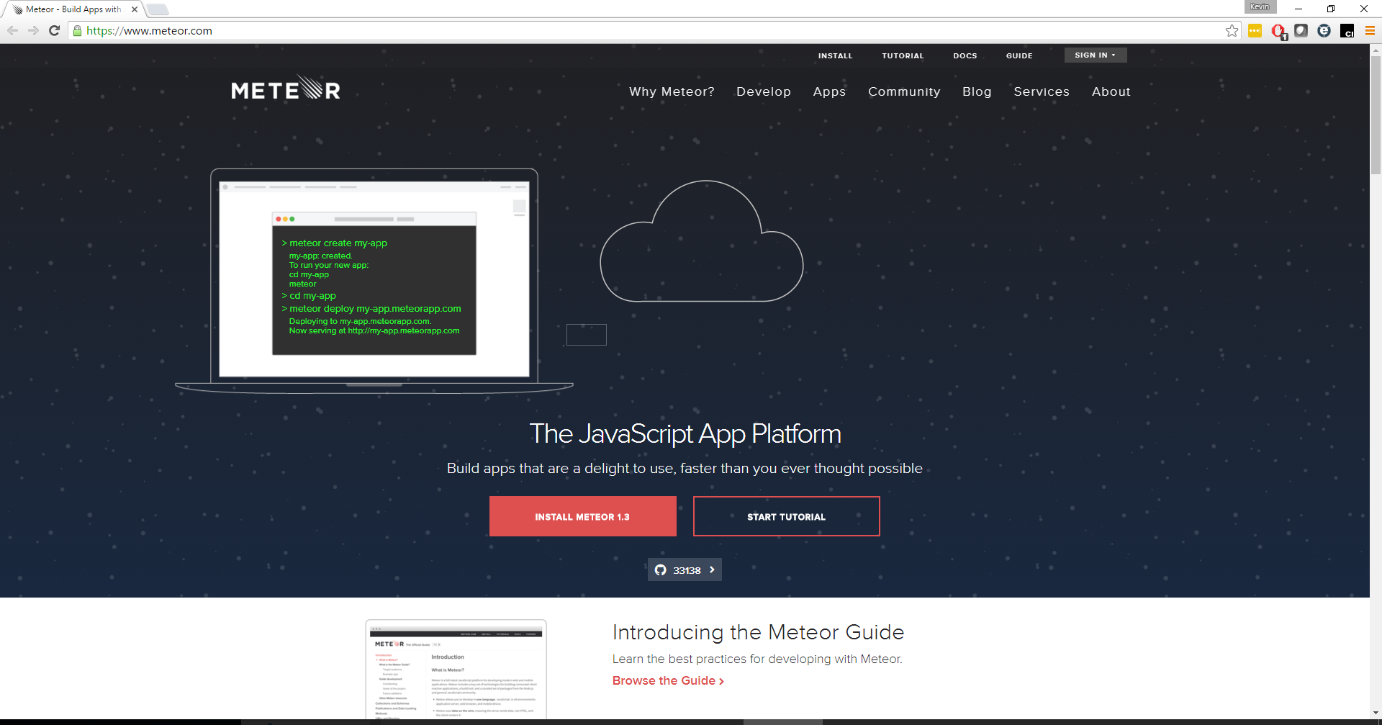
Notes:
Consistent fonts

Slide 12
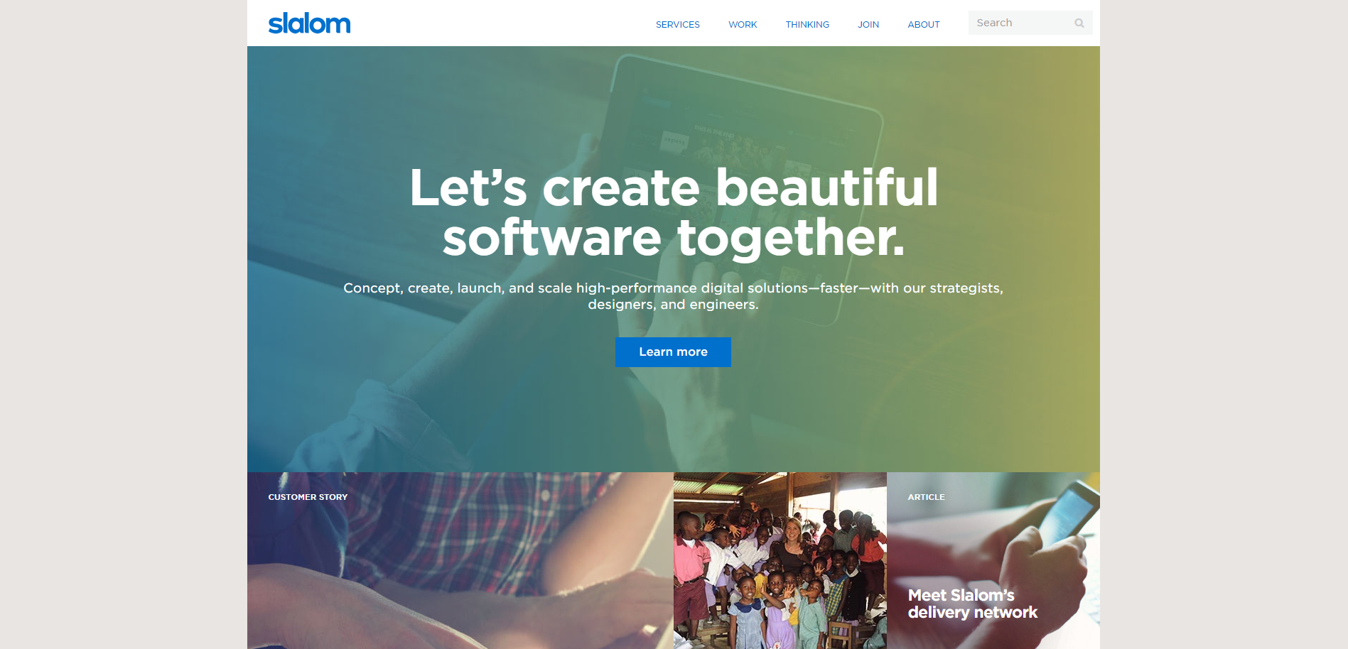
Notes:
Familiar with Slalom and been to our website, we use Bootst
Navigation bar

Slide 13
History of Bootstrap
Developed at Twitter
Style guide for internal sites
v2 responsive
v3 mobile-first
v4 coming out soon
2010 Built at Twitter
2012 Version 2
2013 Version 3
2011 Public Release
2016? Version 4
http://getbootstrap.com/
Notes:
Design framework- what does that mean
Why was it developed
What problem did each release resolve
Invented
Purpose
Different versions

Slide 14
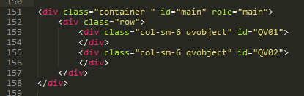
How Bootstrap is Used
HTML
Specifies format of web page
CSS (Cascading Style Sheet)
For HTML elements, assign class defined in Bootstrap
JavaScript
Prebuilt helper functions
Themes
Change standard Bootstrap styling
Notes:
HTML
Structure of web page
Specifies how other components will interact with what you’re seeing
CSS - accomplished by using classes in your HTML
What's CSS - controls colors, fonts, anything that looks different than normal text – is almost always accomplished through CSS
What's a Div - container
What's a class – assigns properties to an element
JS - adds interactivity to your site
Other files/templates/themes
Only going to use CSS, when you start using BS 90% of what you want to do will be using can be accomplished with CSS

Slide 15
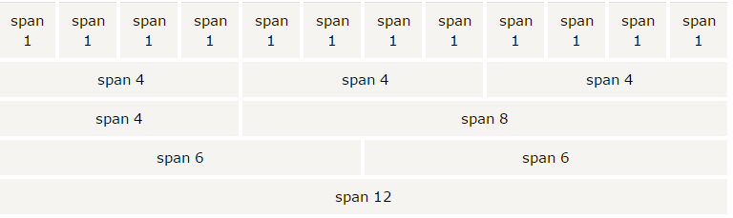
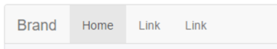
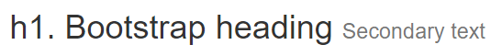
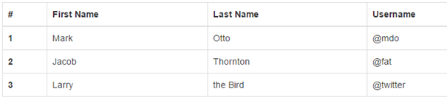
Common Bootstrap Elements
Grid
Navigation Bar
Buttons
Typography
Table
Notes:
Grid - meat of bootstrap
Navbar - really useful, getting code to stick to top of your page and look good is surprisingly hard
Buttons - most recognizable characteristic
Typography - fonts
Table (w/ borders)
Modal - talk about this in the demo
Alerts

Slide 16
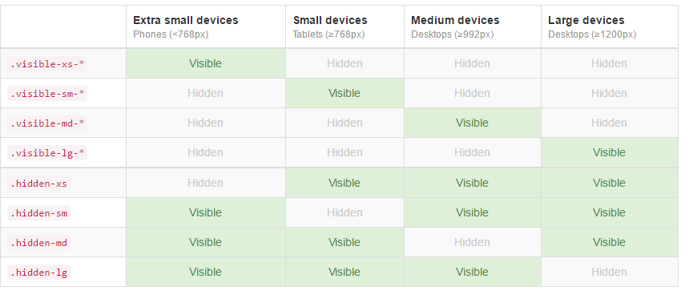
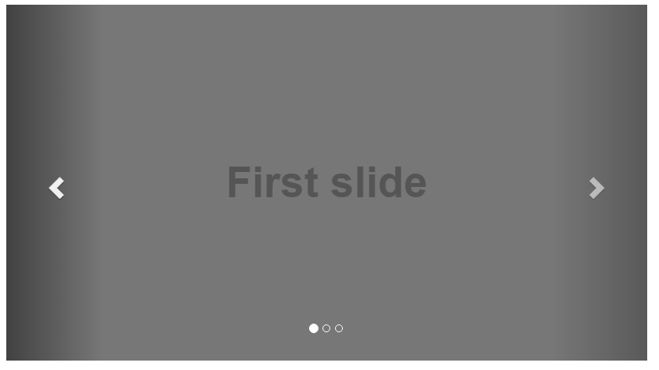
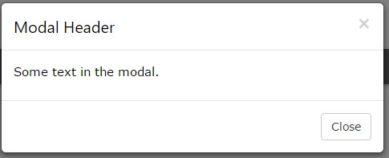
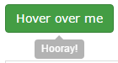
Common Bootstrap Elements (continued)
Display based on screen size
Carousel
Alert
Modal
Tooltip
Notes:
Carousel
Scrollspy
Tooltips - use JS
Icons
Show/hide based on size, responsive

Slide 17
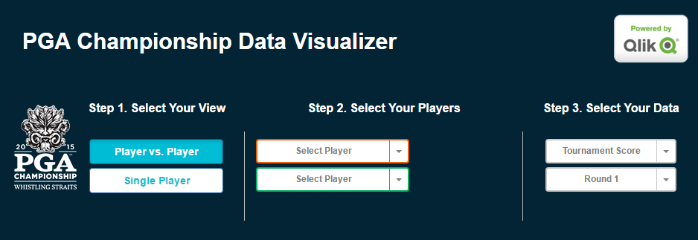
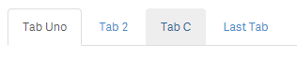
What does this have to do with Qlik Sense?
Mashups
Speed up time to build
Responsive
Extensions
Add some style
Notes:
What is a mashup – taking the Qlik engine and delivering via web page
Allows companies to create web pages that don’t look like typical BI tools
Allows you to expose great looking, interactive web pages
Why would you want to use BS with that? Speeds the time it takes to build
Makes sure web page is desktop+mobile
Already included in some of the templates so no reason not to
Extensions
Create custom components to be brought into Qlik Sense
Once you know Bootstrap, may say, want to make sure the text is standard in my extension or want to center some text inside
Tab extension plug
Requires a little bit of effort to achieve this

Slide 18
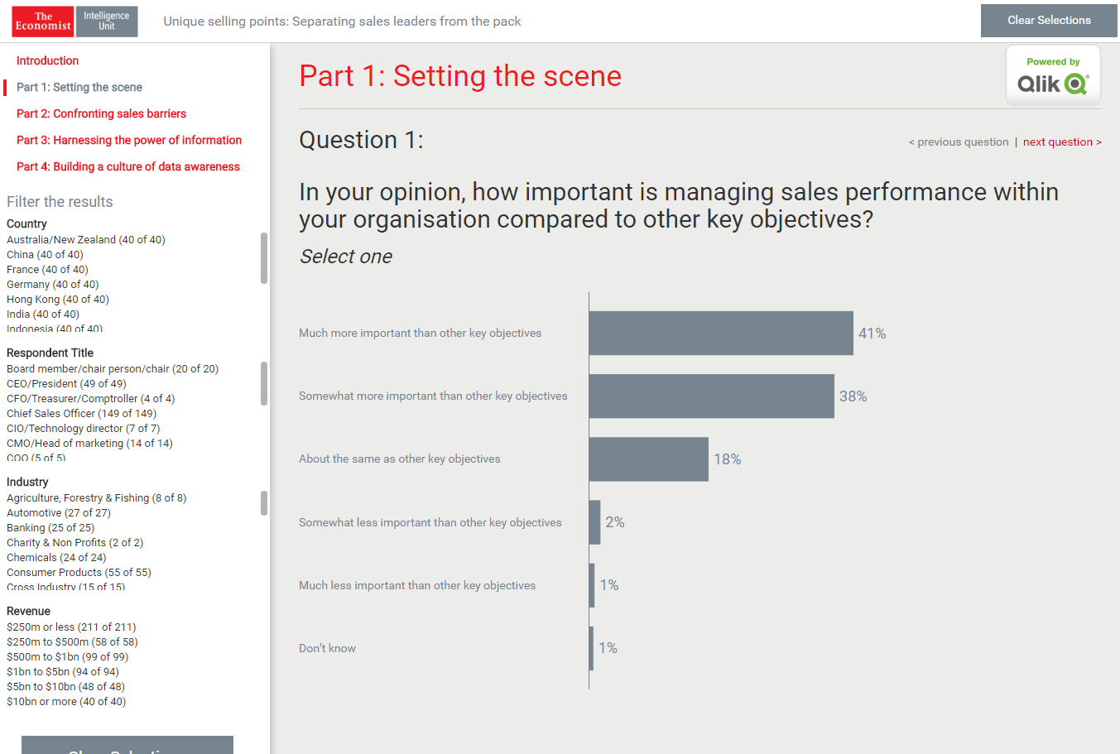
Notes:
Two examples where mashups created with Bootstrap has been used and included some custom styling to achieve colors specific to who built it
Provide a link later to make sure you can go look at these on your own

Slide 19
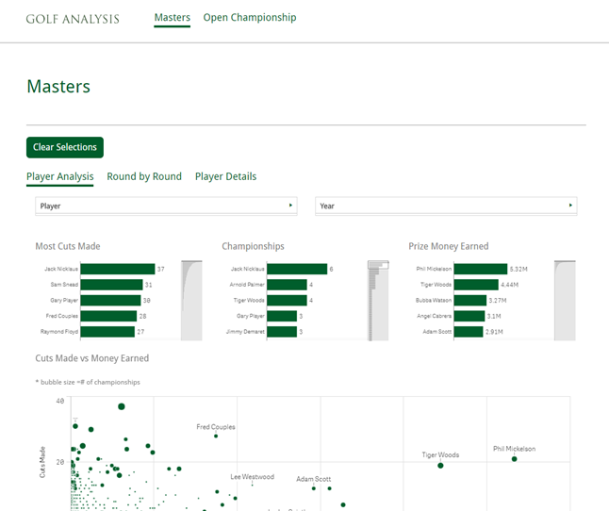
Notes:
Two examples where mashups created with Bootstrap has been used and included some custom styling to achieve colors specific to who built it
Provide a link later to make sure you can go look at these on your own

Slide 20

Considerations before using Bootstrap
Not best for sites with a lot of content to load
“Our load times are already taking 5 seconds or longer”
Sites with a design framework in place (class collision)
“We already have all of this CSS code written”
Notes:
Heavy transaction sites - lot of fluff
Sites with a design framework already in place
Class collision - namespacing

Slide 21
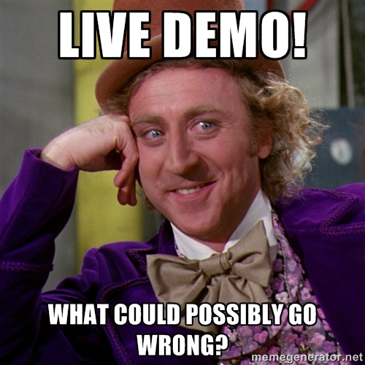
Notes:
What will I be building - navbar, grid, button, header, modal
Create new mashup - favorite template - grid
Open HTML and show CDNs for bootstrap - explain what a CDN (content delivery network) is and why we won't use it and why they may or may not want to use it
Copy files then change paths to relative
Navbar- remove classes and show what happens
Connect to app, and drag charts onto grid
Show classes on grid added by default
Resize browser
Make something disappear on browser resize
Grid options (show page)
add a header, takes care of styling
Get some bonus header classes - text-center, text-danger is most useful one
Below grid, add button
Show page with button options (show page)
Give button classes of btn and btn-primary
Btn not very useful without action tied to it
Show modal code below
Tie button to modal - helpful if you need to force users to enter a form and don't want them to have to leave the page
Speaking of forms, ton of configuration options on forms (show page)
Other options, between two pages have just about anything you would want to use in BS

Slide 22

Summary
Framework for building quick, clean webpages
Used throughout the web, well documented
Can help build quick Qlik Sense mashups and extensions
Included with most mashup templates
Needs some work before it can be used in an extension
Notes:
What we covered
What you hopefully got out of it

Slide 23
Resources
@mcgovey
mcgovey
Presentation GitHub Repository
Qonnections16-QS-Bootstrap
Bootstrap References
Bootstrap Download
Cheat Sheet
Tutorials
Themes
Scoping Bootstrap
Stefan Walter’s Blog Post
Stefan Walter’s Tutorial
Namespaced-Bootstrap file

Slide 24
@mcgovey
mcgovey
Resources used in this presentation
The Masters Mashup
Economist Survey Mashup
PGA Mashup
My Tabs Extension

Slide 25


Questions?
@mcgovey
mcgovey
Questions?
Where can I find these slides and examples?
Where can I find these slides and examples?
https://git.io/vw481

